Slide 1
Restaurant Management System
By Yi Yang, Kun Chen, Rui Da

Slide 2
Product Introduction
This product will be a generically designed restaurant management system. It can be imported to any kind of restaurant, providing functionality such as making reservation, checking in, making an order and checking out.

Slide 3
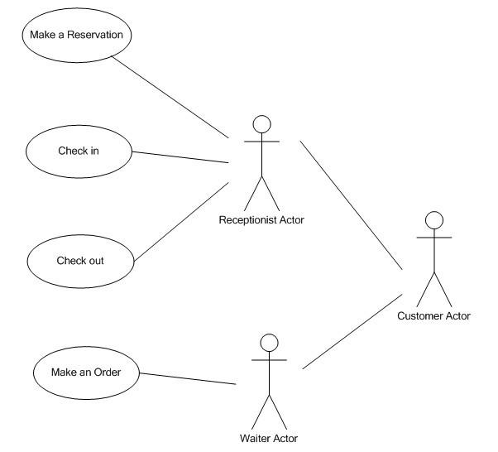
Use Case Diagram

Slide 4
Use Case: Make a Reservation
Actor: Receptionist
Goals: Help customer make a reservation for a specific date and time.
Precondition:
Summary: Receptionist finds available table for the specific date and time, record contact information, reserves the table for customer.
Related use case: None

Slide 5
Steps:
Actor actions System responses
1. Select “Reservation” command 2. Pop up reservation window
3. Select date and time, then search 4. Display all available tables the system
5. Select table size, type into 6. Pop up message indicates customer’s name and cell phone, making reservation successfully
submit reservation
7. Return to main window
Postconditions: table reserved for customer, record inserted into database, available table number decreases

Slide 6
Scenarios
Make a reservation
Steps:
Actor actions System responses
Select “Reservation” command Pop up reservation window
Set October 20 for date and Display all available tables
dinner for time, then search the
system
Type customer name “David”, Pop up message indicates making
cell phone “336-334-1234”, reservation successfully
reserve the table
Return to main window

Slide 7
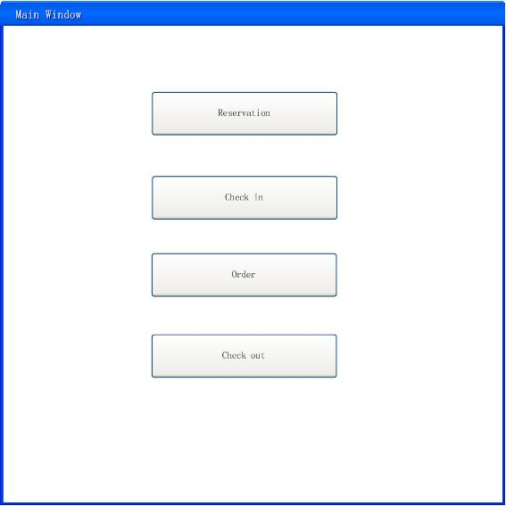
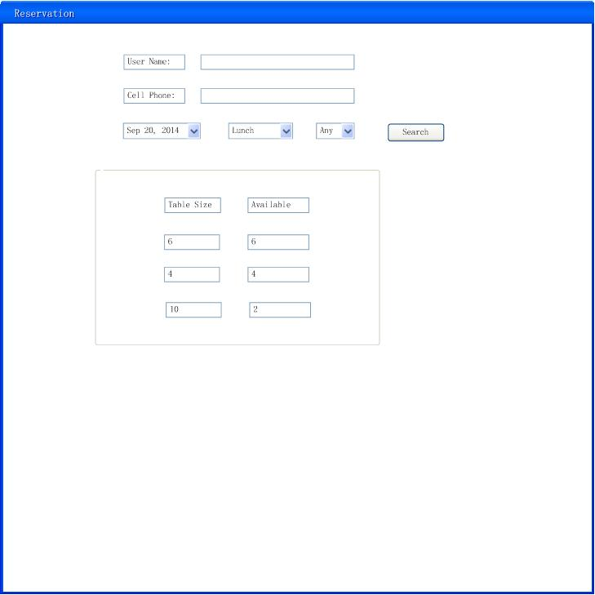
Interface

Slide 8
Use Case: Check In
Actor: Receptionist
Goals: Assign an available waiter and seat to customer.
Preconditions: The receptionist must have the basic information of the customer.
Summary: When a certain customer comes to the front desk, receptionist needs to get basic information of this customer and use this software to find out an available seat and waiter to serve.

Slide 9
Steps:

Slide 10
Scenarios 1
Actor actions System responses
1.Choose “check in” command 2. Display a new interface to prompt receptionist to type last name of customer, cell phone number and group size.
3.Input “Chen” into “user name”
text box
4. Input “123-345-3232” into “cell phone”
text box
5. Input “4” into “group size” text box
6. Click “Search”
7. Display “David” (Waiter’s name), “3”(Table number)
8.Click”OK”
9. Go back to the original interface

Slide 11
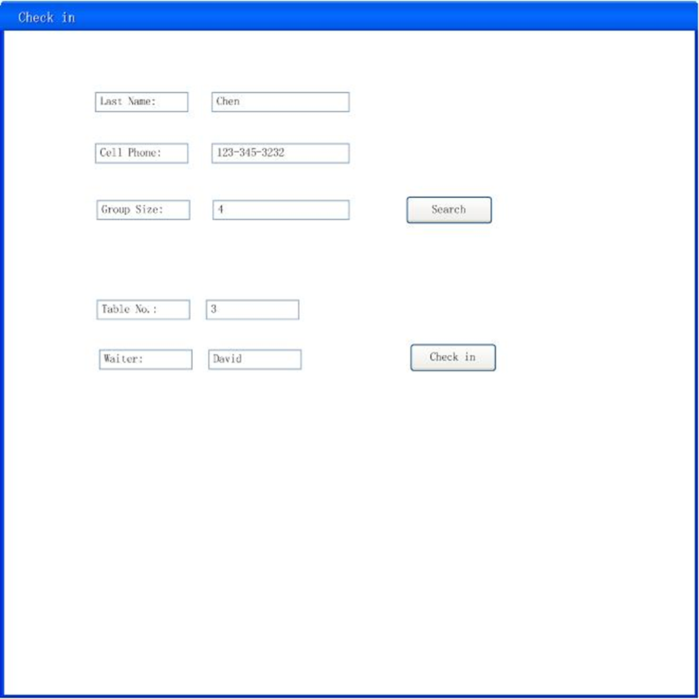
Sketch 1

Slide 12
Scenarios 2
Actor actions System responses
1.Choose “check in” command 2. Display a new interface to prompt receptionist to type last name of customer, cell phone number and group size.
3.Input “Chen” into “user name”
text box
4. Input “123-345-3231” into “cell phone”
text box
5. Input “4” into “group size” text box
6. Click “Search”
7. A message box pops out and shows that “Invalid information for reservation”
8.Click”OK”
9. Go back to the original interface

Slide 13
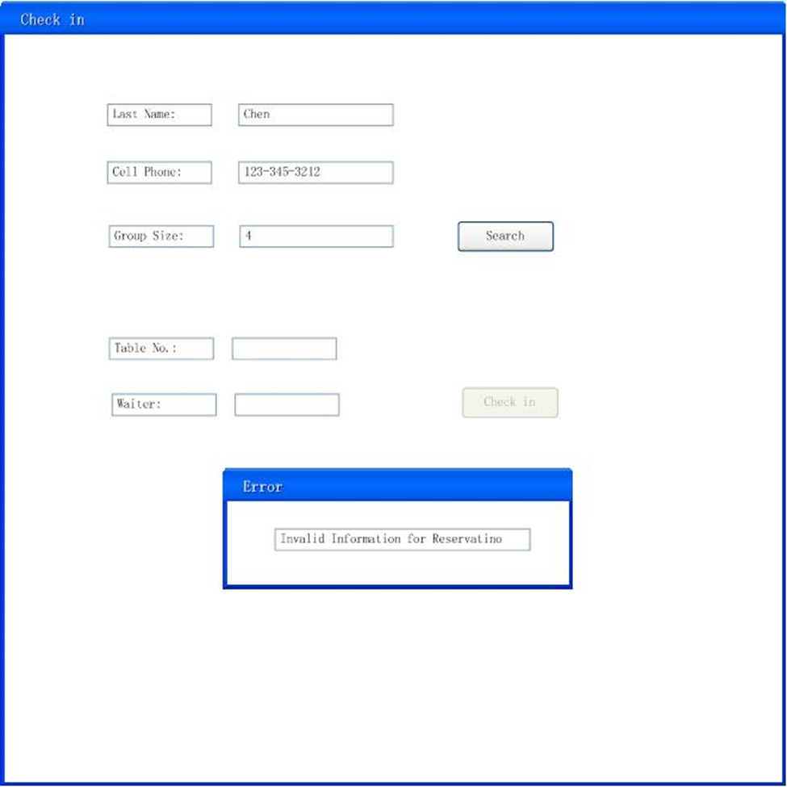
Sketch 2

Slide 14
Use Case: Make An Order
Actors: Waiter
Goals: To make an order
Preconditions: Guests must have checked in successfully
Summary: Price will prompt up and total will be computed after each guest has finished an order
Post condition: Order information should be recorded to database successfully

Slide 15
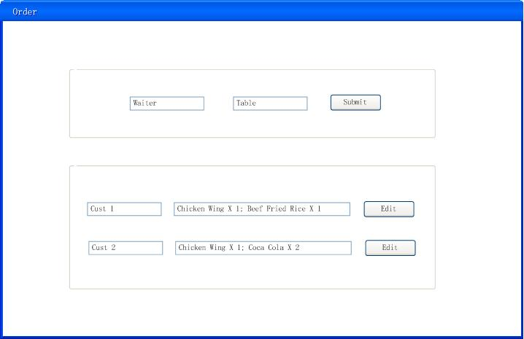
Order Page

Slide 16
Steps:
Actor actions System responses
1. Choose “Order”. 2. Direct to order page.
3. Type in waiter’s name and 4. Direct to menu page.
table number, then click
“Submit”.
5. Click “Appetizer”, “Entrée” 6. Prompt a list of menu.
or “Dissert” to order.
7. Sort the courses by hitting 8. Display courses of the chosen the
sorting button. category.
9. Check the courses and input 10. Display the course names and the amount, click “Done” total price. Display “Next” button,
when the order is completed. if any other guests need to order, then go to step 2. Otherwise, display a textbox for table number and a “Print” button.
11. Type in table number, click 12. Print out an order summary of
“Print”. this table.

Slide 17
Scenarios
Steps:
Actor actions System responses
1. Click on “Order” button. 2. Display the order page, ask for number of guests.
3. Type in “2”, click “Submit”. 4. Display the menu page for guest 1.
5. Click “Appetizer”, check
“Chicken Wings” and type in
“2”.
6. Click “Entrée”, check “Beef
Ramen” and type in “1”.
7. Click “Done”. 8. Display “Chicken Wings × 2, Beef Ramen × 1, Total Price $15.00” and “Next” button.

Slide 18
9. Click “Next” button. 10. Display the menu page for guest 2.
11. Click “Entrée”, check “Beef
Ramen” and type in “1”.
12. Click “Dissert”, then click 13. Display all the ice cream.
“Ice Cream”.
14. Check “Coconut Ice Cream”
and type in “1”.
15. Click “Done”. 16. Display “Coconut Ice Cream × 1, Total Price $3.00” and “Print” button, and a textbox for table number.
17. Type “Table 1”, click “Print”. 18. Display “Table 1: Chicken Wings × 2, Beef Ramen × 2, Coconut Ice Cream × 1” on the receipt.

